Slide 1
Computer Science
Tony Gaddis 5th Ed Starting Out with C++
Chapter 6
Functions
Mohammad Al-Husseini

Slide 2
Modular Programming
Functions can make our code:
Shorter
Better Organized
Easier to Read
Easier to Debug
More Reusable
More Efficient
And just generally better
You’ve already used many functions
main, pow, strcmp, and more
But you will learn to create your own

Slide 3
Defining a Function
You have to first define your function, before you can use it
Function Definitions contain the following:
Return Type – The type of value that will be returned from the function (int, char, etc)
Void is a new data type (exclusive to functions) that indicates no value returned
Name – Programmer Defined and Meaningful
Parameter List – Data that will be sent into the function along with their data types
Body – Enclosed within braces, this is the code that the function will run when it is called

Slide 4
A Familiar Function
int main ( ) { cout << “Hello World!”; return 0; }
Name
Return Type
Parameter List (Empty)
Body
Return Value

Slide 5
Calling a Function
Calling means to execute/run the function
When you define a function, you create the function header
void helloWorld ()
When you call the function, you use its name and an argument list
helloWorld();
Parameters are values that a function takes in
Arguments are values that are given to a function
When a function finishes executing, it returns to the point at which it was called in the code

Slide 6
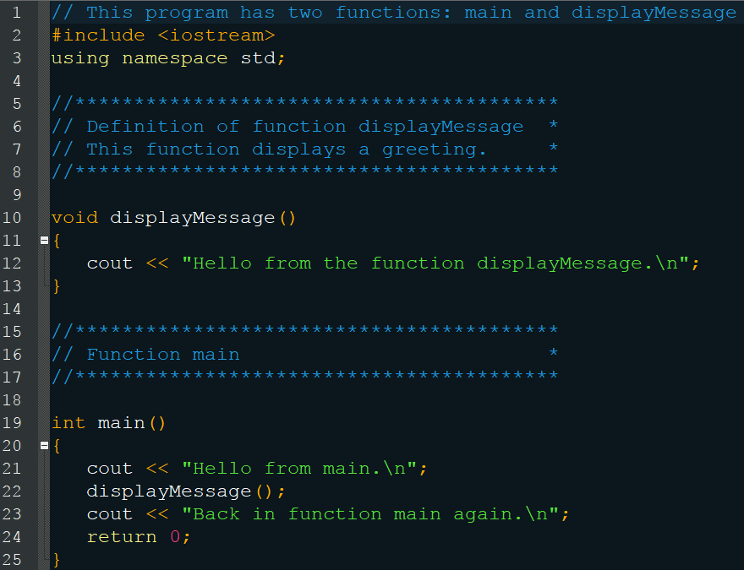
Calling a Function

Slide 7
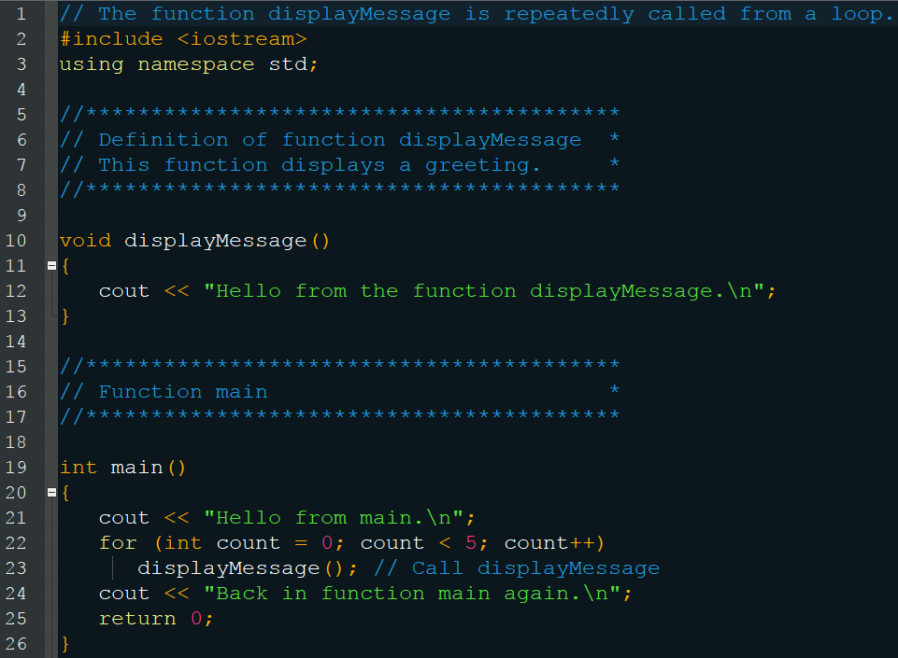
Call Them Everywhere

Slide 8
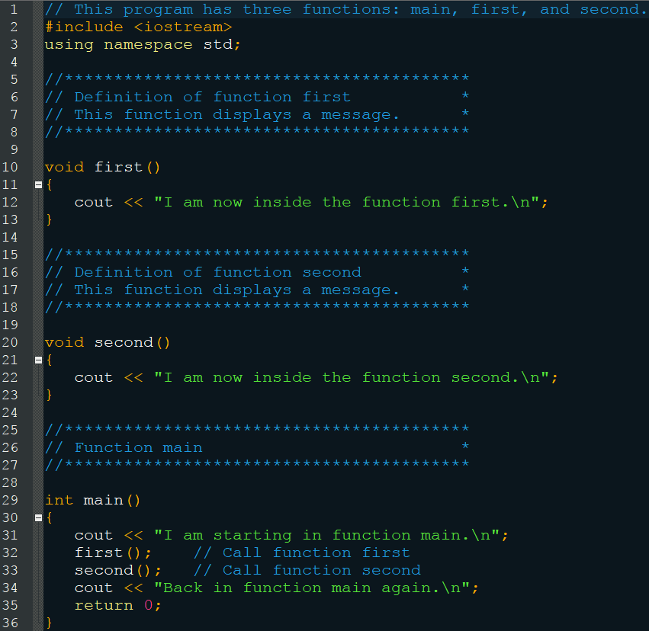
Multiple Functions

Slide 9
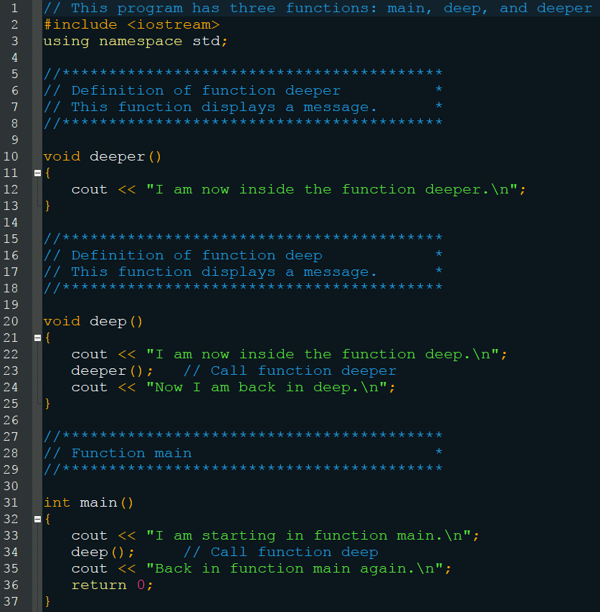
Call Them Everywhere

Slide 10
Checkpoint
Is the following a function header or call?
calcTotal();
void showResults()
helloWorld()
Assume the user enters 10 into the program on the next page. What will the program display?

Slide 11
Checkpoint
#include <iostream>
using namespace std;
void func1()
{
cout << “Able was I” << endl;
}
void func2()
{
cout << “I saw Elba” << endl;
}
int main()
{
int input;
cout << “Enter a number: “;
cin >> input;
if (input < 10)
{
func1();
func2();
}
else
{
func2();
func1();
}
return 0;
}

Slide 12
Function Prototypes
Also known as Function Declarations
A function must be defined before it is called
This requires you to put the entire function above function main
But this isn’t a great solution and many programmers prefer to see main first
Instead of defining the function first, you can place a prototype first instead
This is just the header of the function
void displayMessage();
The function must be defined later in the code

Slide 13
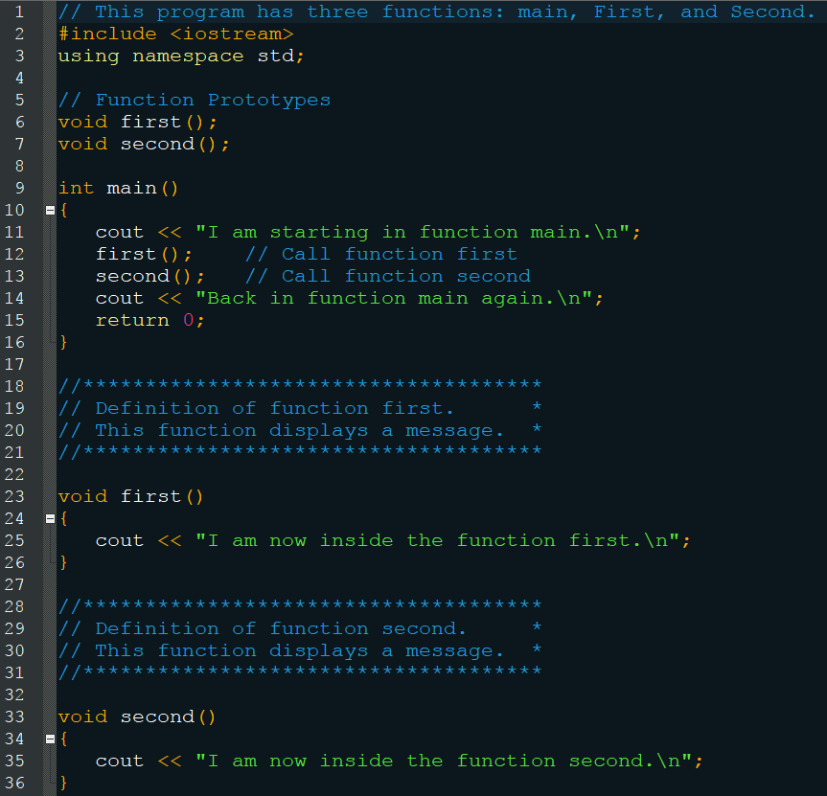
Function Prototypes

Slide 14
Sending Data into a Function
Known as passing arguments (or actual parameters) in the function call
This is received by parameters (or formal parameters) in the function header
void displayValue(int num)
int num is a parameter
displayValue(5)
5 is an argument
The above function call causes the argument 5 to get stored in the parameter num
They must match data types

Slide 15
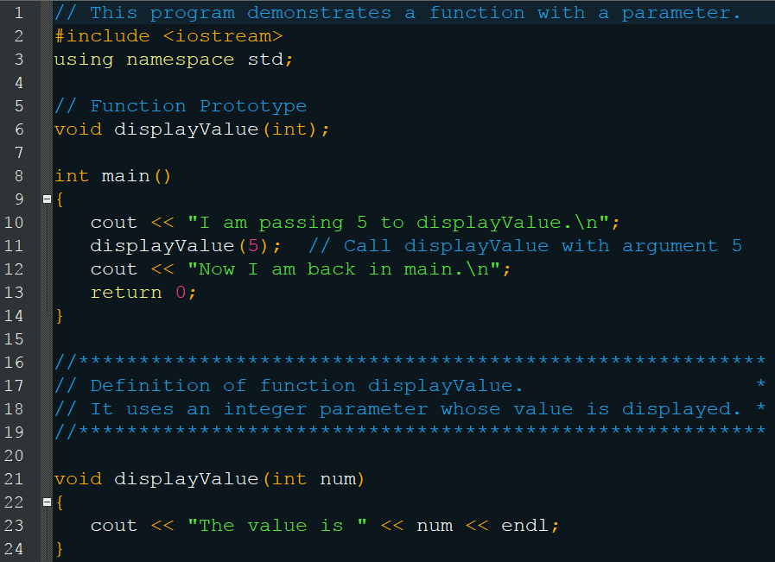
Sending Data into a Function

Slide 16
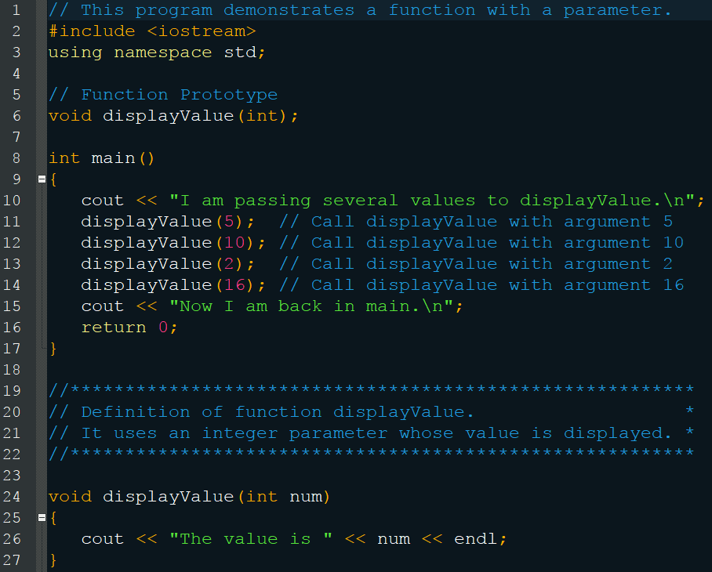
Sending Data into a Function

Slide 17
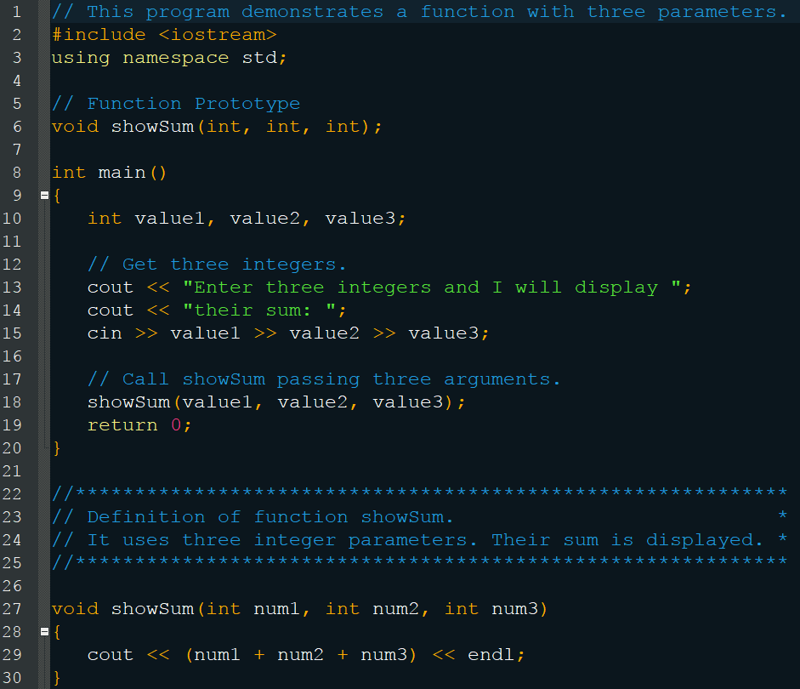
Sending Data into a Function

Slide 18
Sending Data into a Function
Notes:
Do not put the data type in the function call
displayValue(int x); // Wrong
In the function prototype, the variable name is optional
void showSum(int num1, int num2, int num3);
The prototype must list the data type for each parameter though
Arguments go into Parameters in the order in which they are placed (int n1, int n2) (4, 5)
Parameters, like all variables, have scope limited to the body of the function

Slide 19
Passing Data by Value
By default, an argument is passed to a parameter by value
This means the parameter becomes a copy of the argument
Which means changing the parameter does not affect the argument
Later, you will learn how to create this behavior

Slide 20
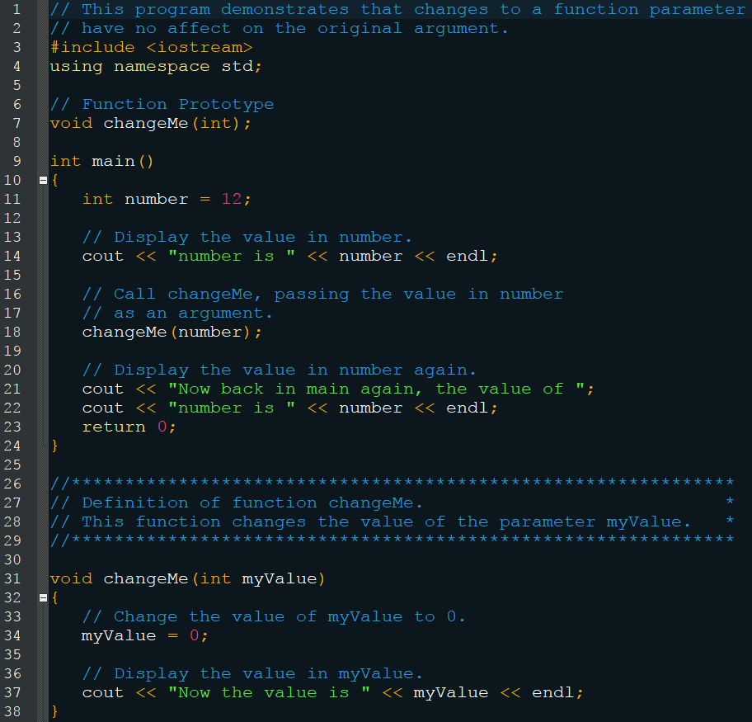
Passing Data by Value

Slide 21
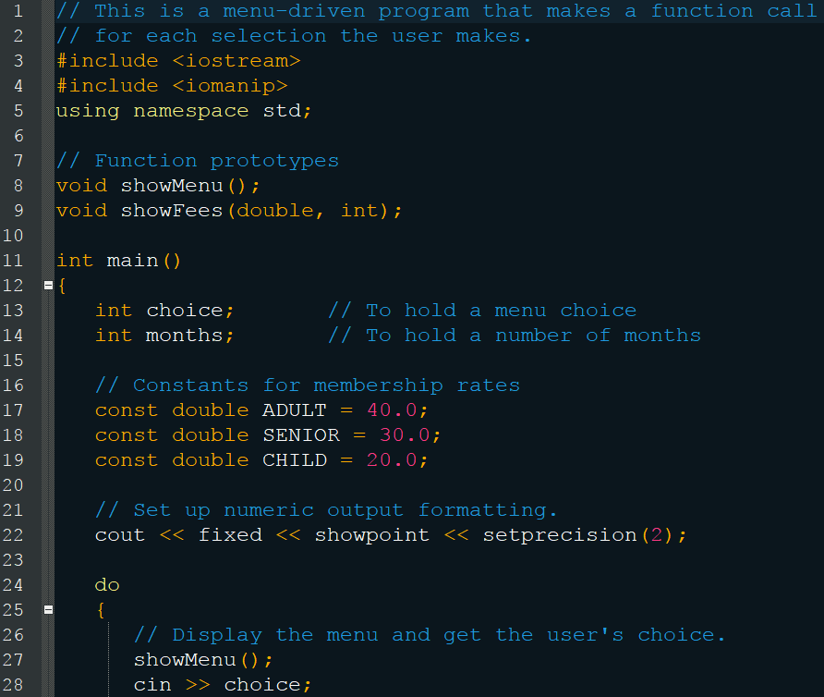
Menu Example

Slide 22
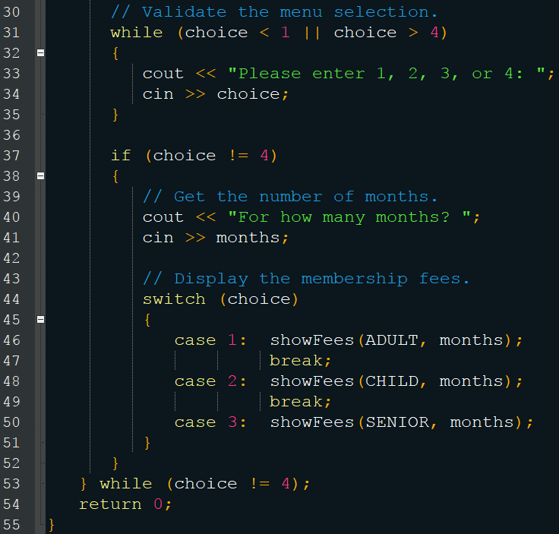
Menu Example

Slide 23
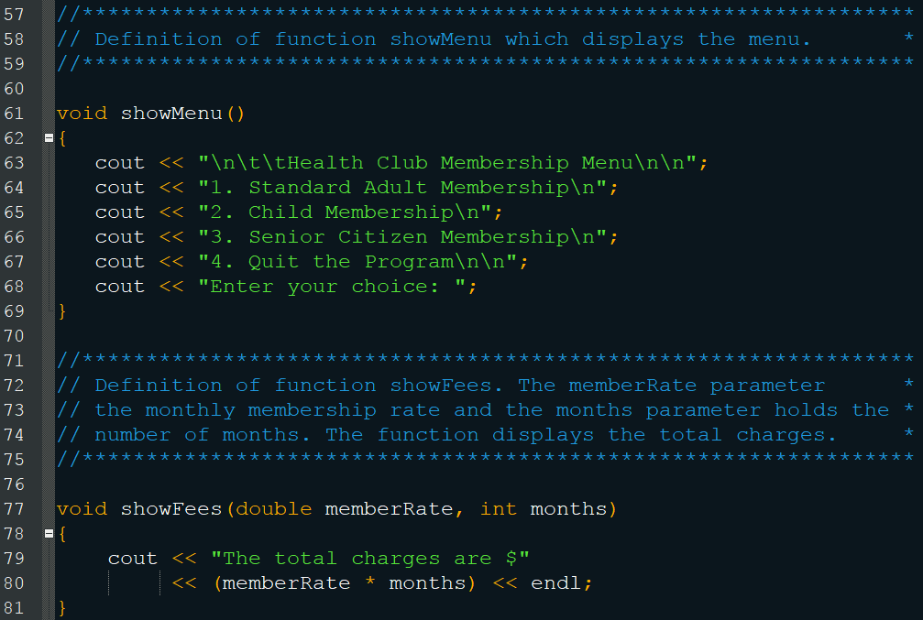
Menu Example

Slide 24
Checkpoint
Indicate whether the following are function prototypes, headers, or calls:
void showNum(float num)
void showNum(float num);
void showNum(float);
showNum(num)
showNum(num);
showNum(45.67);

Slide 25
Checkpoint
What is the output of the following program:
void showDouble(int); int main() { for (int num = 0; num < 10; num++) showDouble(num); return 0; } void showDouble(int value) { cout << value << “\t” << (value * 2) << endl; }

Slide 26
Checkpoint
What is the output of the following program:
void func1(double, int); int main() { int x = 0; double y = 1.5; cout << x << “ “ << y << endl; func1(y, x); cout << x << “ “ << y << endl; return 0; } void func1(double a, int b) { cout << a << “ “ << b << endl; a = 0.0; b = 10; cout << a << “ “ << b << endl; }

Slide 27
The return Statement
Causes the function to end immediately
You’ve utilized this behavior with main
That ends the program, but only because main is a special function
Other functions will return to the point at which they were called
This can be used even if the function is void
Which means it doesn’t return a value, but return still ends the function
In this case (void) the return is optional
Other types must include a return though

Slide 28
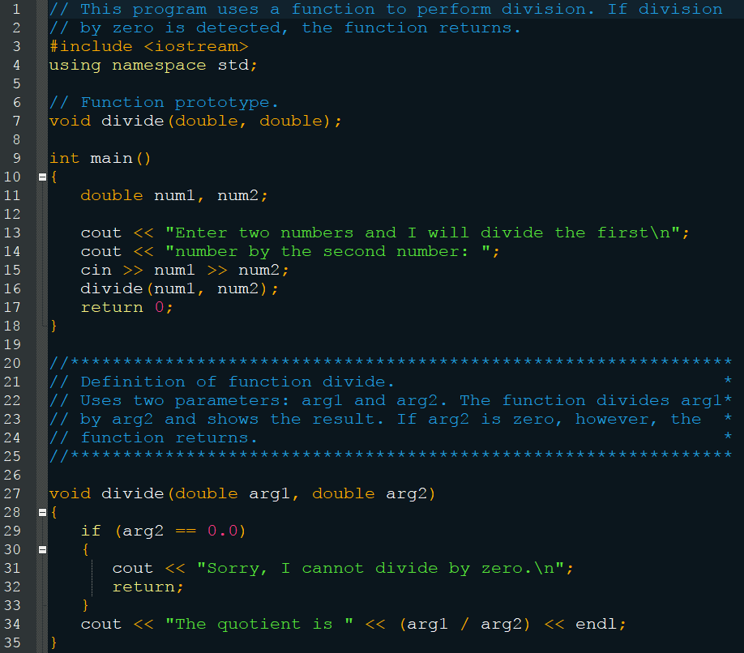
The return Statement

Slide 29
Returning a Value
The function must be of non-void type
You must use a return statement
You can only return a single value
Until we learn more in Chapter 11
The value returned is a copy of the data in the function
This is because all data within a function is destroyed after it is finished executing
The value replaces the call to the function in the code
You could even use the return value as the argument to another function

Slide 30
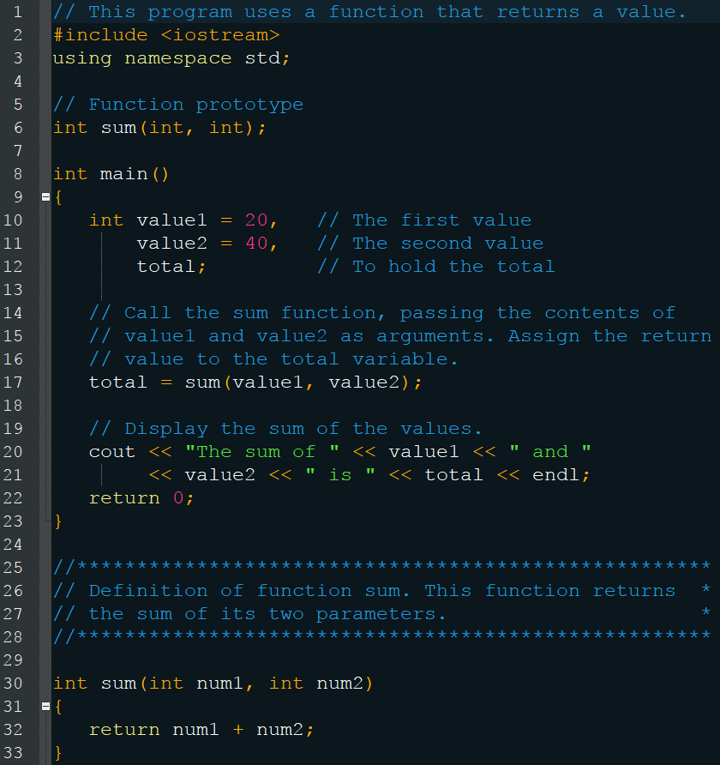
Returning a Value

Slide 31
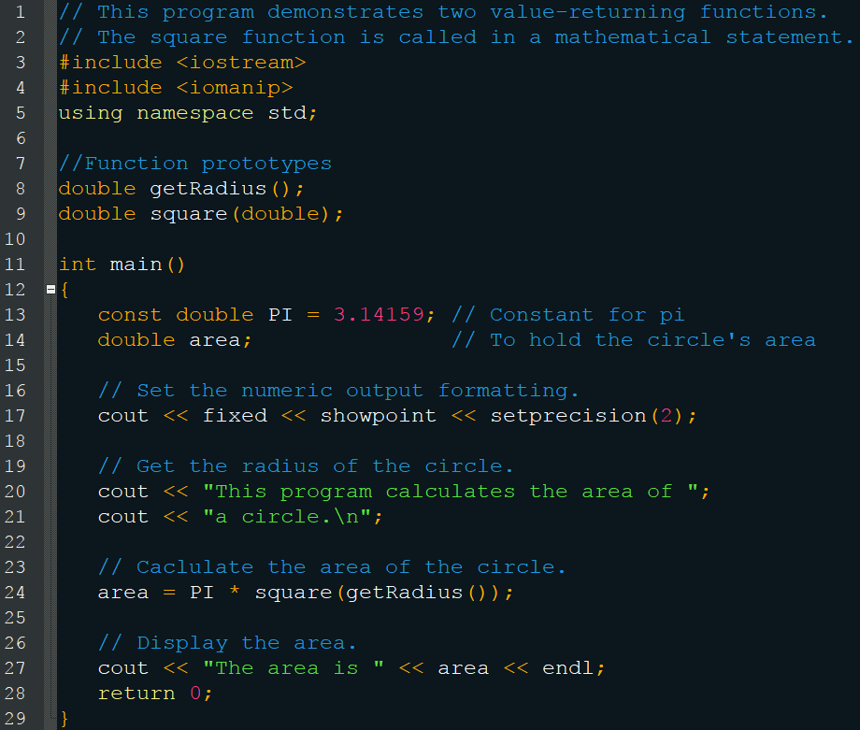
Using a Return as an Argument

Slide 32
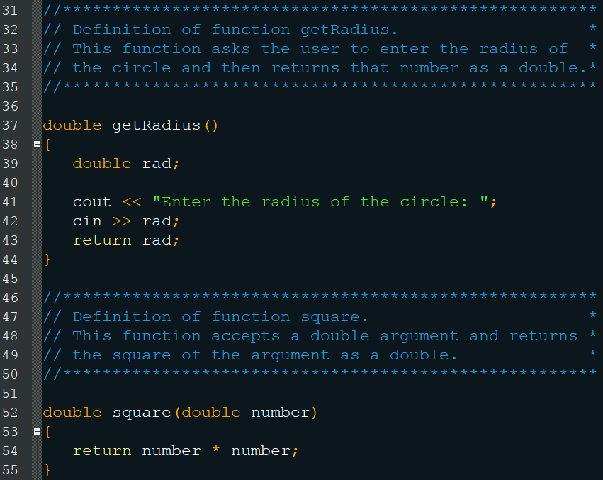
Using a Return as an Argument

Slide 33
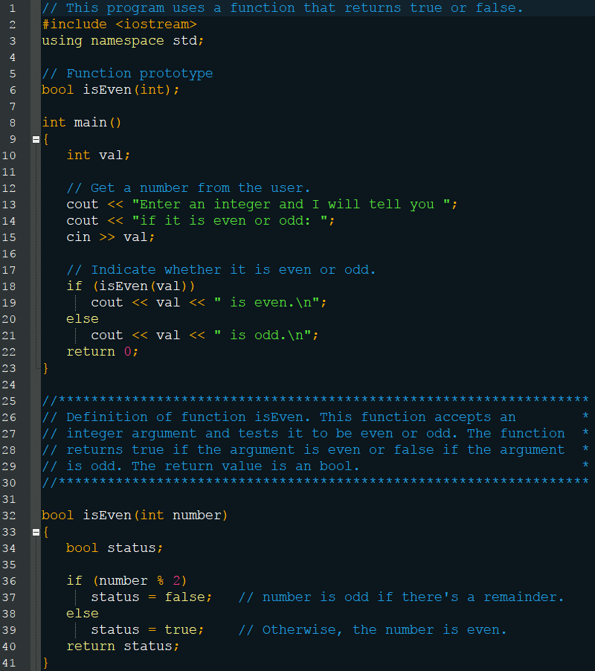
Returning a Boolean Value

Slide 34
Checkpoint
How many return values can a function have?
Write a header for a function named distance. The function should return a double and have two double parameters: rate and time.
Write a header for a function named days. The function should return an int and have three int parameters: years, months, and weeks.

Slide 35
Checkpoint
Write a header for a function named getKey. The function should return a char and use no parameters.
Write a header for a function named lightYears. The function should return a long and have one long parameter: miles.

Slide 36
Local Variables
Variables which are inside or local to a function
These are the variables you have been using so far
As long as they are contained within different sets of braces, they can even share the same name

Slide 37
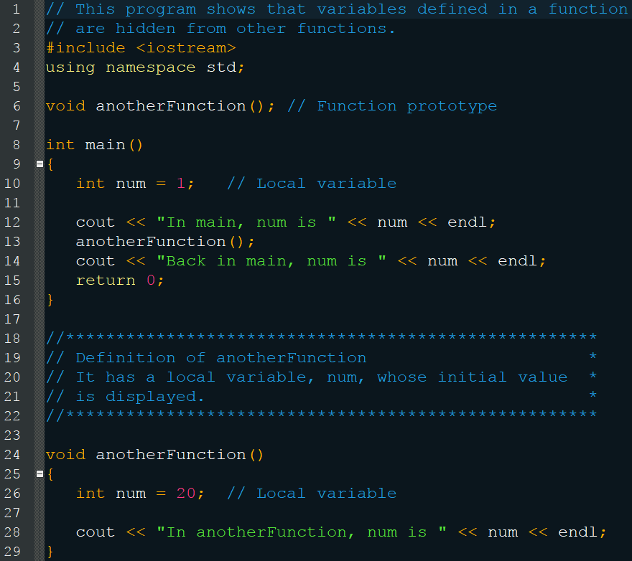
Local Variables

Slide 38
Local Variables
Think of the int num in main as main::num and the int num in anotherFunction as anotherFunction::num
In this regard, they are different
Recall that anotherFunction::num’s lifetime is only as long as we are running anotherFunction
Also think of parameters are local variables
int sum(int num1, int num2) { return num1 + num2; }

Slide 39
Global Variables
Variables defined outside of any function
The scope of these variables is the entire program
Which means that all code can access and change the value of global variables
You must use these only when absolutely necessary or (sometimes) when they are constant
You can run into a lot of problems if you aren’t careful with your global usage
Unlike local variables, they are automatically initialized to 0 if you do not initialize them

Slide 40
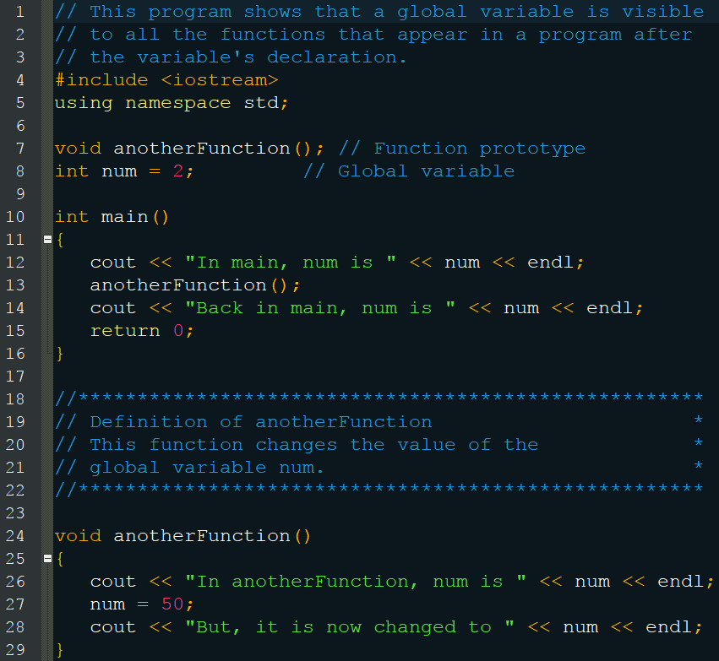
Global Variables

Slide 41
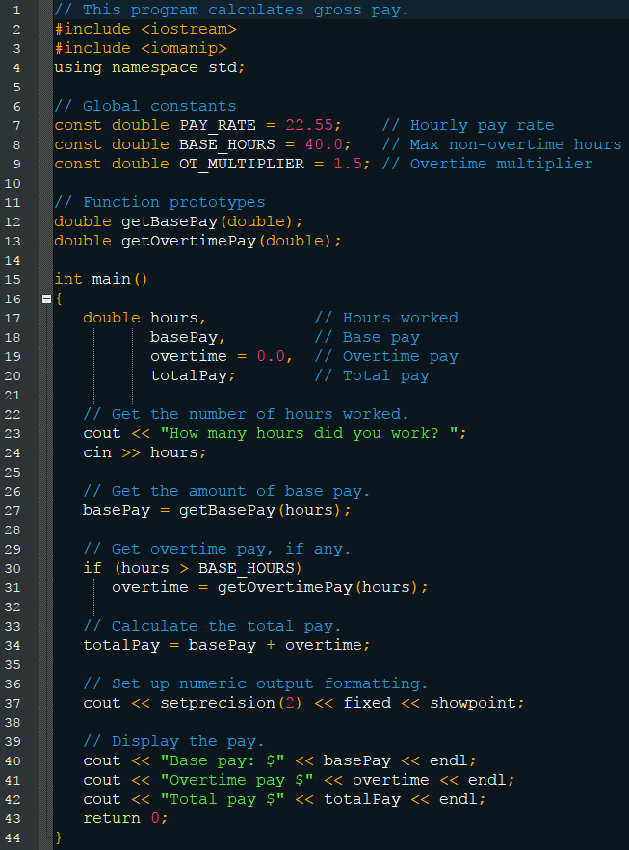
Global Variables

Slide 42
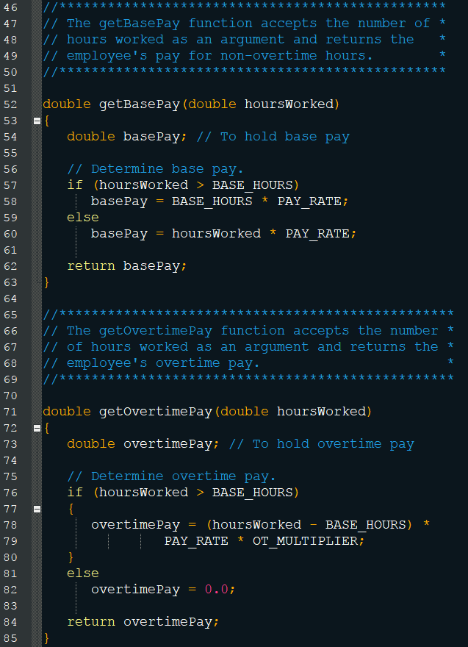
Global Variables

Slide 43
Mixing Local and Global
Two local variables in the same scope cannot share the same name
But a local variable can share a name with a global variable
When this happens, the local variable shadows the global
This means that while the local variable is in scope, it’s value will be used instead of the global

Slide 44
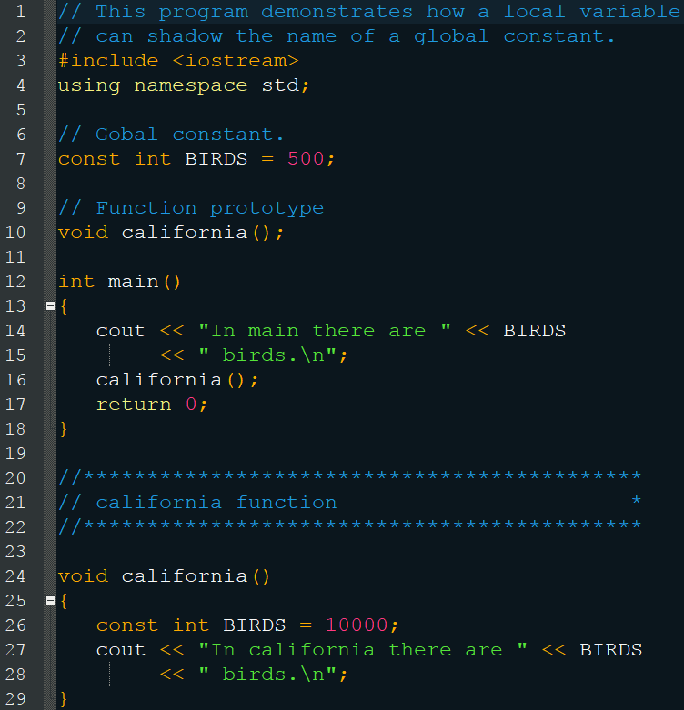
Mixing Local and Global

Slide 45
Static Local Variables
Recall that once a function is finished executing, that all local variables are destroyed
If you want to prevent this effect, you can declare the local variables as static
Their initialization happens only the first time they are run
And their values are maintained throughout the course of the program running

Slide 46
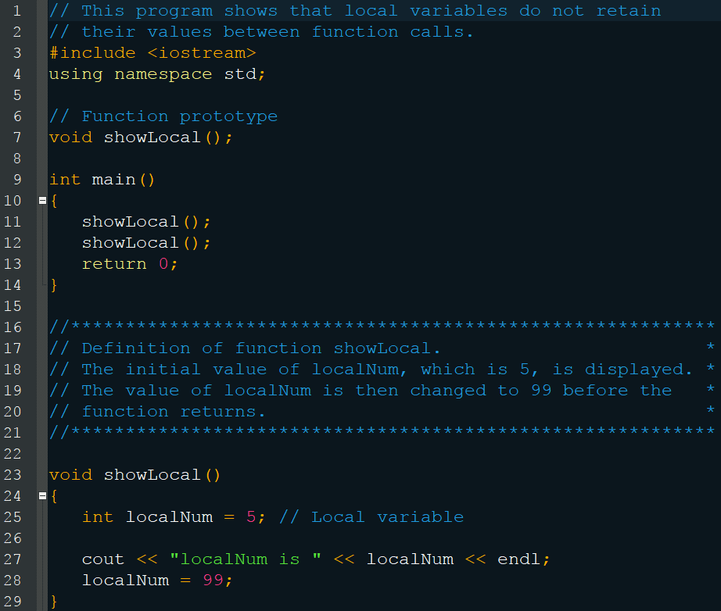
Static Local Variables

Slide 47
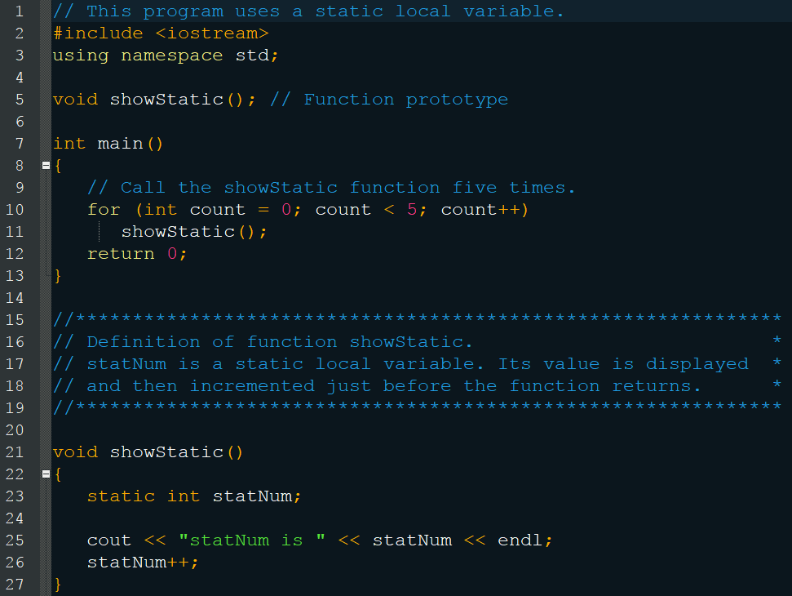
Static Local Variables

Slide 48
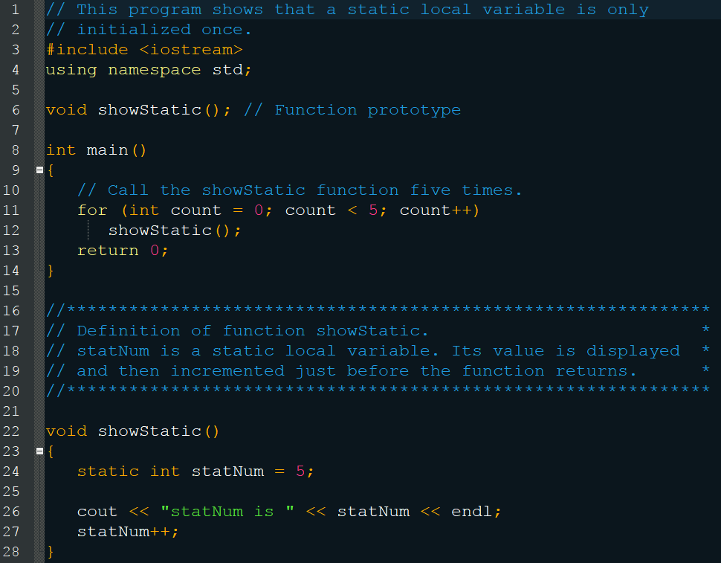
Static Local Variables

Slide 49
Checkpoint
What is the difference between a local variable, static local variable, and a global variable?

Slide 50
Checkpoint
What will the following display:
void myFunc() { int var = 50; cout << var << endl; }
int main() { int var = 100; cout << var << endl; myFunc(); cout << var << endl; return 0; }

Slide 51
Checkpoint
What will the following display:
void showVar() { static int var = 50; cout << var++ << endl; }
int main() { for (int count = 0; count < 10; count++)
showVar(); return 0; }

Slide 52
Default Arguments
Arguments which are passed to the parameters of a function if no arguments are provided (must be literal or constant)
They are included in the function prototype, or in the function header if there is no prototype, but not both
Whichever occurs first
All, some, or none of the parameter list may contain default arguments
If only some of the parameters have default values, they must the ones that appear last void calcPay(int empNum, double hours = 10);

Slide 53
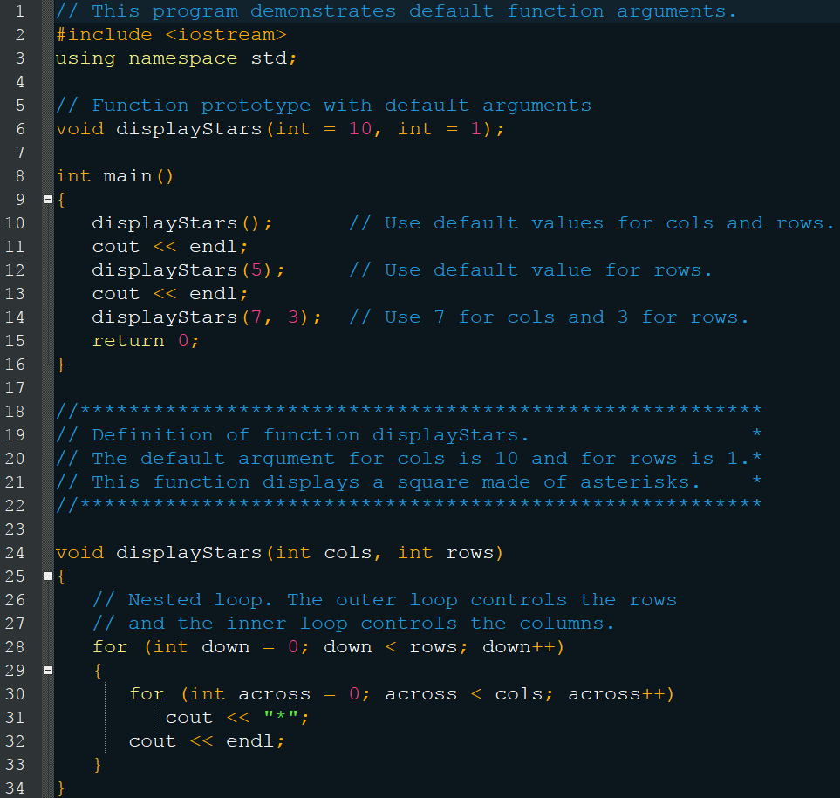
Default Arguments

Slide 54
Reference Variables
We said that arguments are passed by value and make a copy
Reference variables are those that are passed by reference, which means they can be changed by the function
It’s just like using a regular parameter, but you place a & after the data type
This is done in the function prototype and header, but not in the call
This passes the memory address, not the value

Slide 55
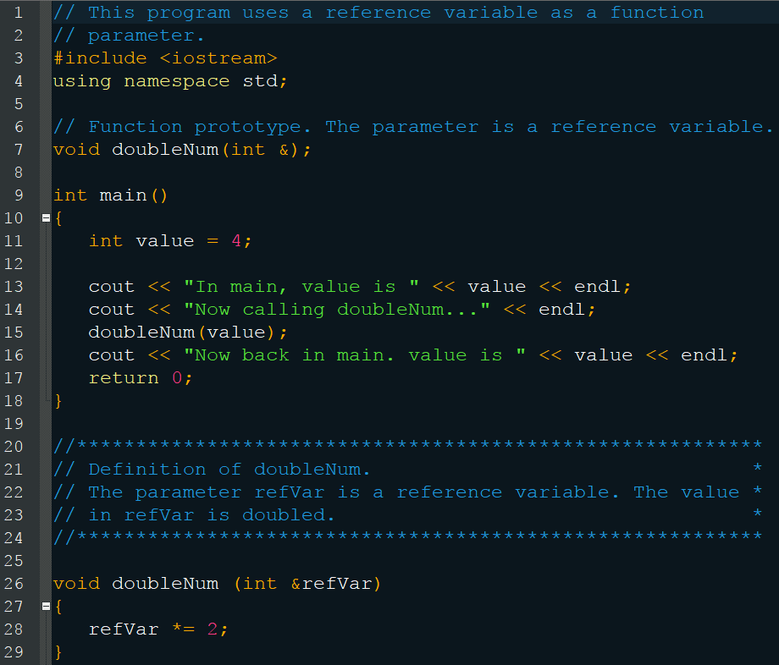
Reference Variables

Slide 56
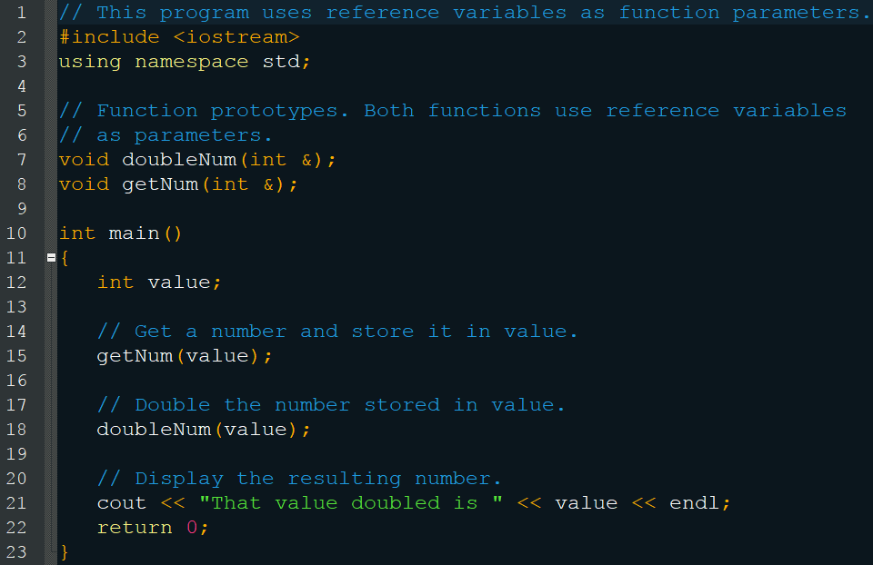
Reference Variables

Slide 57
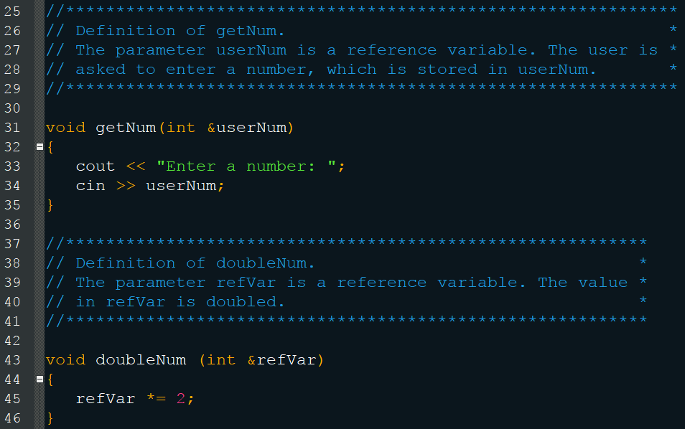
Reference Variables

Slide 58
Reference Variables
Notes:
Only variables may be passed by reference
doubleNum(5) // Wrong
doubleNum(userNum + 10) // Wrong
Don’t get carried away with reference variables
You only want to use them when the function actually needs access to change the variable
You can run into hard to fix bugs if you aren’t careful

Slide 59
Checkpoint
What kinds of values may be specified as default arguments?
Write the prototype and header for a function called compute. The function should have three parameters: an int, a float, and a long (not necessarily in that order). The int parameter should have a default argument of 5, and the long parameter should have a default argument of 65536. The float parameter should not have a default argument.

Slide 60
Checkpoint
Write the prototype and header for a function called calculate. The function should have three parameters: an int, a reference to a float, and a long (not necessarily in that order). Only the int parameter should have a default argument, which is 47.

Slide 61
Checkpoint
What will the following display:
void test(int first = 2, int second = 4, int third = 6) { first += 3; second += 6;
third += 9;
cout << first << “ “ << second << “ “ << third << endl; }
int main()
{
test();
test(6);
test(3, 9);
test(1, 5, 7);
return 0;
}

Slide 62
Checkpoint
What will the following display:
void func1(int& a, int& b)
{
cout << “Enter two numbers: “;
cin >> a >> b; }
void func2(int& a, int& b, int& c)
{
b++; c--; a = b + c;
}
void func3(int a, int b, int c)
{
a = b – c; }
-continued on next page-

Slide 63
Checkpoint
int main()
{
int x = 0, y = 0, z = 0;
cout << x << “ “ << y << “ “ << z << endl;
func1(x, y);
cout << x << “ “ << y << “ “ << z << endl;
func2(x, y, z);
cout << x << “ “ << y << “ “ << z << endl;
func3(x, y, z);
cout << x << “ “ << y << “ “ << z << endl;
return 0;
}

Slide 64
Overloading Functions
Like local variables, functions cannot share the same name
Unless their parameter lists are different
The number and/or data types must vary
This can be extremely useful however, unlike with local variables
Certain math functions need to be modified based on what type of number it is (int, float, etc.)
Or you don’t know how many parameters you’ll need
int sum( int num1, int num2, int num3, …);
But you just want one function call that “works”

Slide 65
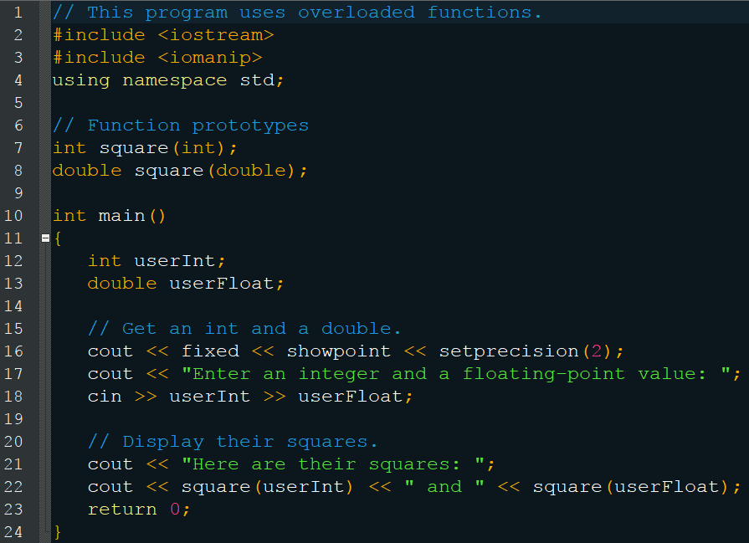
Overloading Functions

Slide 66
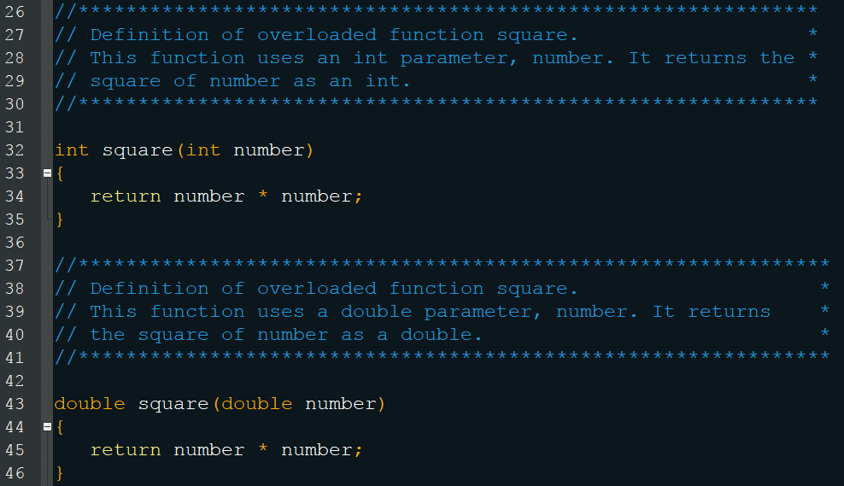
Overloading Functions

Slide 67
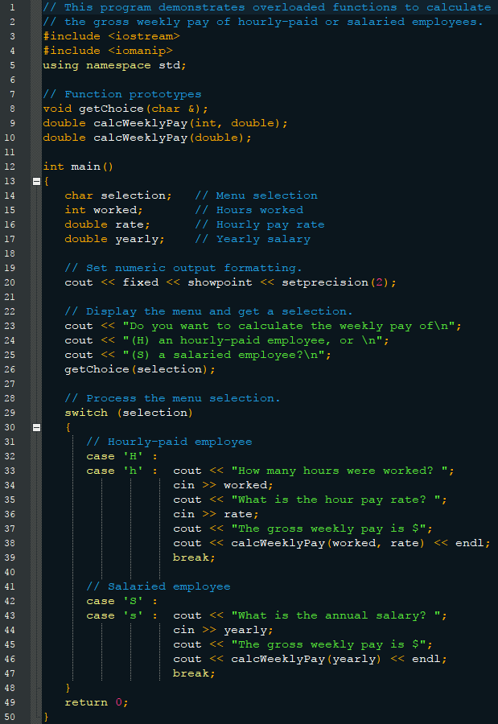
Overloading Functions

Slide 68
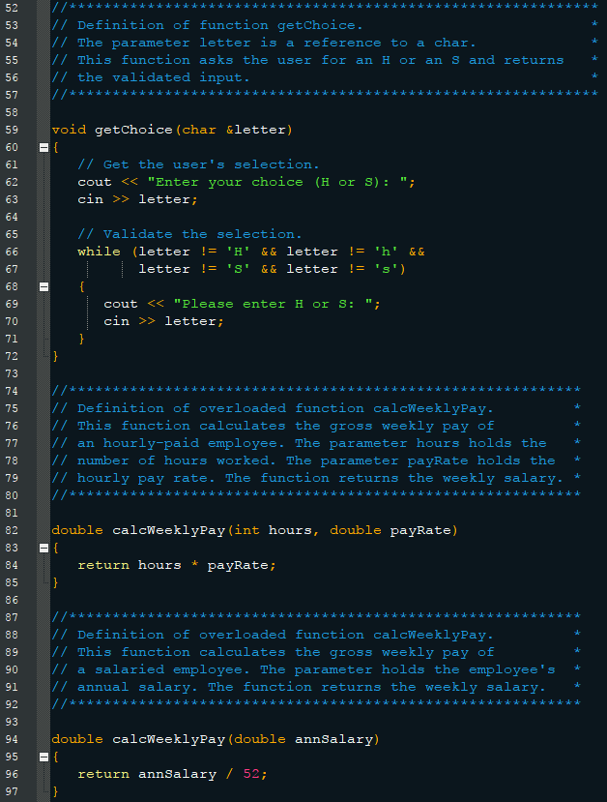
Overloading Functions

Slide 69
The exit() Function
Return causes the function to stop executing
Which in the case of main causes the program to end
But sometimes you want this functionality within a function, exit() does just that
Requires #include <cstdlib>
You can pass it an integer argument to indicate an exit code
Usually 0 or EXIT_SUCCESS
Or some negative value
But this is only needed if your program is tested outside of main

Slide 70
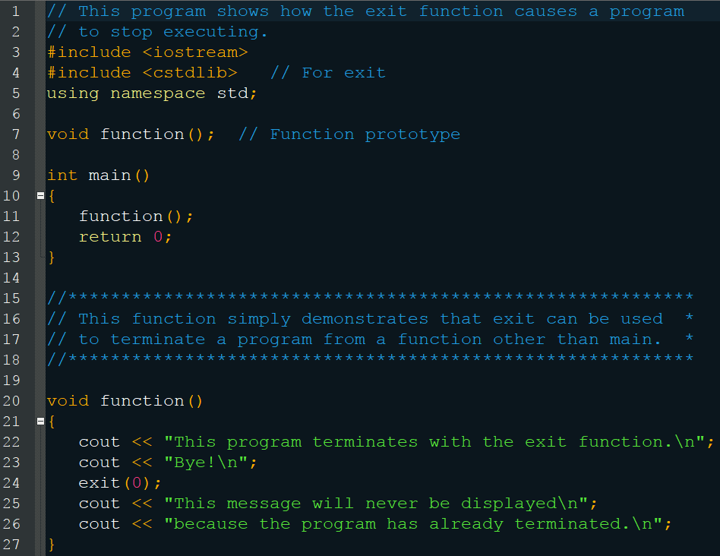
The exit() Function

Slide 71
Checkpoint
What will the following output:
void showVals(double, p1, double p2) {
cout << p1 << endl;
exit();
cout << p2 << endl; }
int main()
{
double x = 1.2, y = 4.5; showVals(x, y);
return 0;
}

Slide 72
Checkpoint
What will the following output:
int manip(int val) {
return val + val * 2; }
int manip(int val1, int val2) {
return (val1 + val2) * 2; }
int manip(int val1, double val2) {
return val1 * static_cast<int>(val2);
}
-continued on next page-

Slide 73
Checkpoint
int main()
{
int x = 2, y = 4, z;
double a = 3.1;
z = manip(x) + manip(x, y) + manip(y, a);
cout << z << endl;
return 0;
}

Slide 74
Stubs and Drivers
Tools for testing your code in a large or team environment
Stubs are dummy functions used to test your main
Drivers are dummy mains used to test your functions
This is useful if you want to focus on finishing your main before writing your functions or vice versa
Or if a member of your team is writing the function and you need to test your main or vice versa

Slide 75
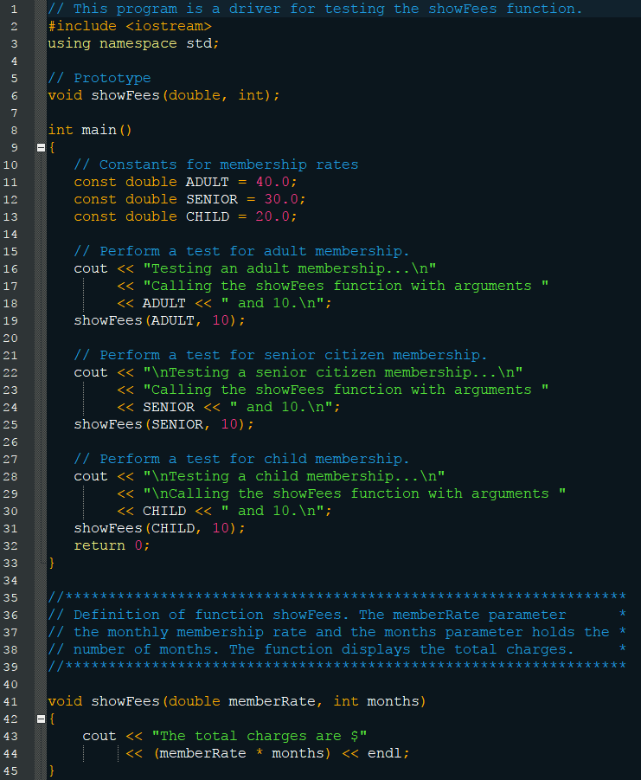
Stubs and Drivers

